Slide 1
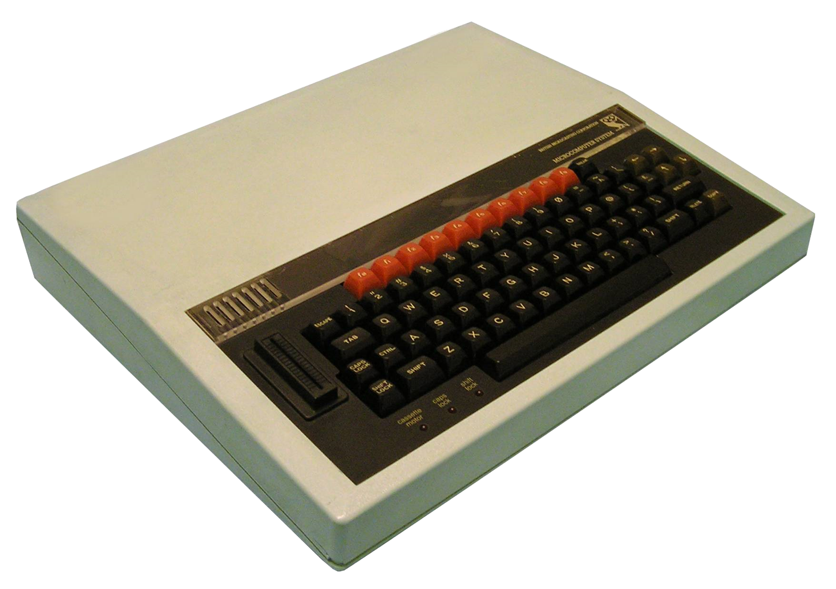
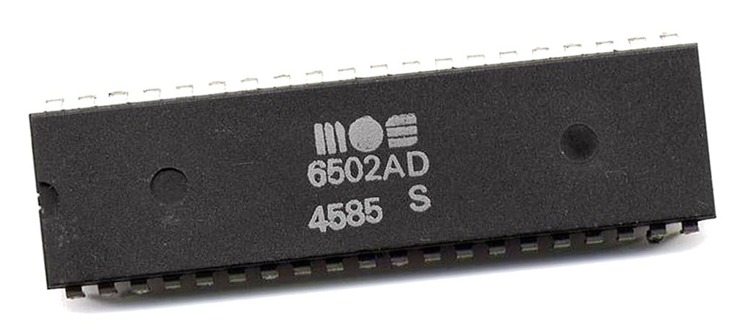

Towards Emulation of the BBC Micro Computer

Slide 2

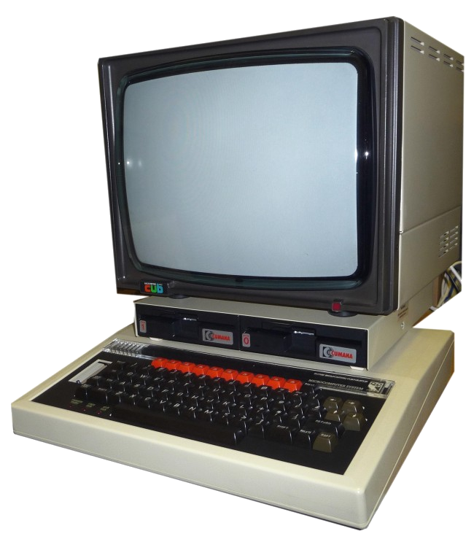
Some History
BBC Computer Literacy Project
Launched 1981
Manufactured by Acorn
2 MHz MOS Technology 6502/6512
RAM 16–32 KiB
Graphics - 6845 CRTC
8 Modes
160 × 256 8 Colours 640 × 256 1 Colours, Teletext
Sound – Texas Instruments SN76489 ADSL

Slide 3

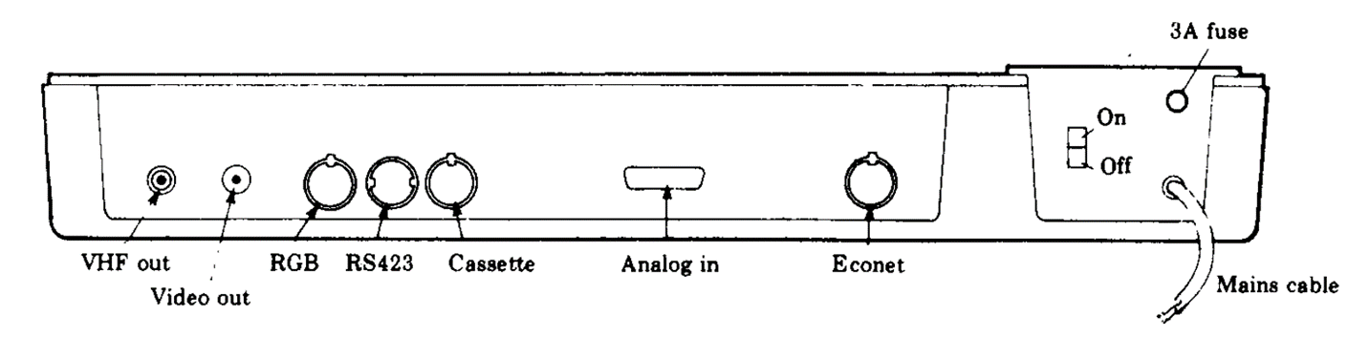
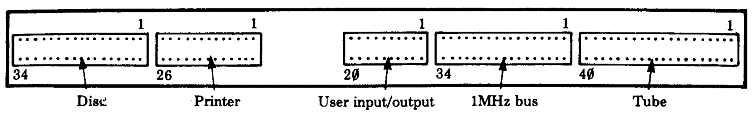
Expansion

Slide 4
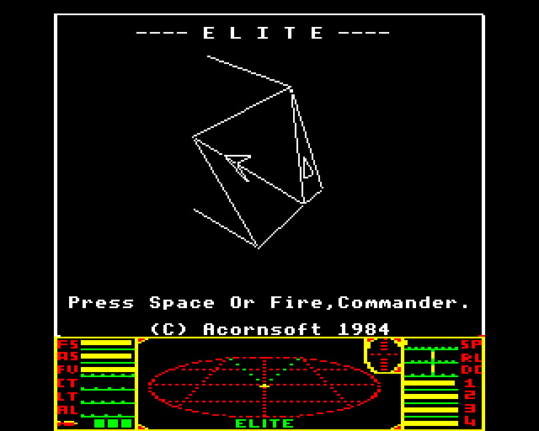
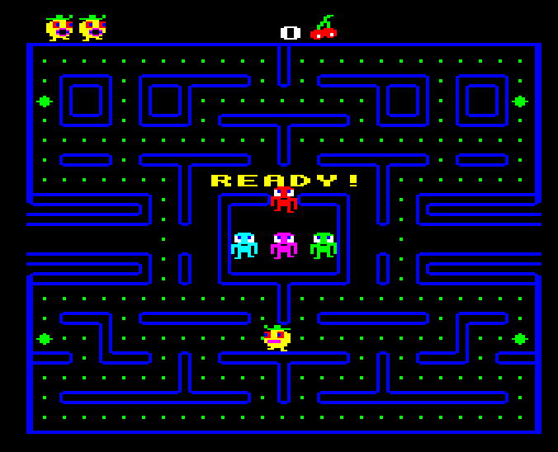
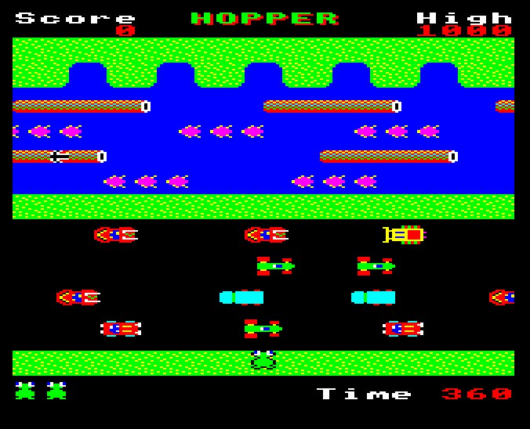


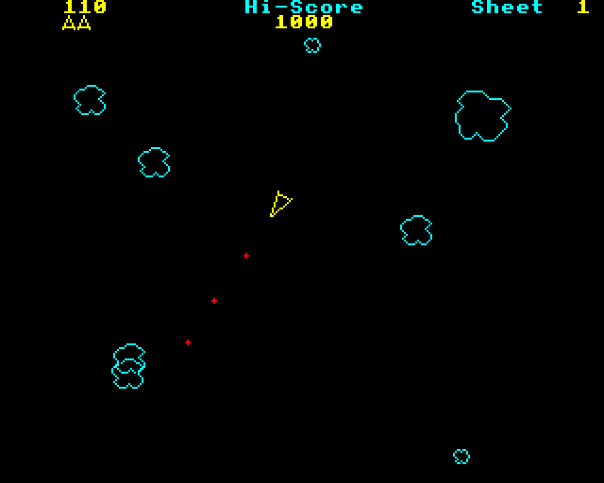
Software - Games
Elite
Pacman (Snapper)
Frogger (Hopper)
Defender (Planetoid)
Centipede (Bug Blaster)
Asteroids (Meteors)

Slide 5
Software - other
Languages (ROMS)
Basic, Pascal, Forth, BCPL, LISP, Logo/Turtle graphics
Business
Word processors (Wordwise), Spreadsheet (ViewSheet), Accounting, Database
Educational
Maths, Physics, Electronics, Geography, Chemistry

Slide 6
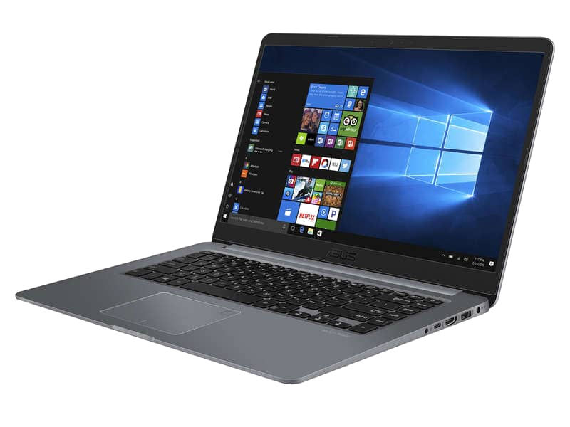
An Emulator you say…
Allows software written for one type of computer to run without modification on another…
… by recreating the hardware of the old system as software on the new system

Slide 7

Step 1
CPU
Memory
Basic I/O

Slide 8
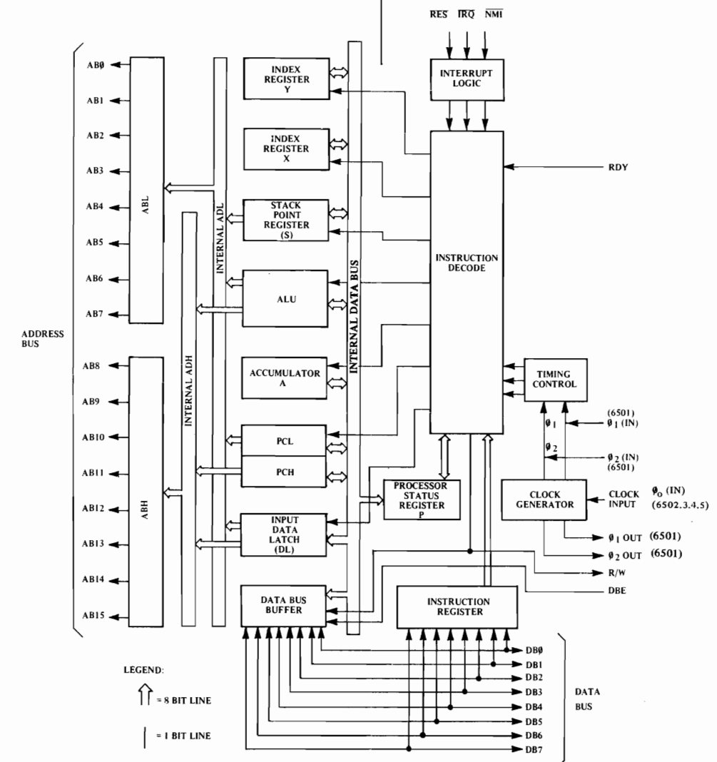
The 6502 Microprocessor
Clock speed – 2 MHz
Transistors - ~3500
Buses
Data – 8 bit
Address – 16 bit => 64K address space
Registers
1 Program counter (PC) 16 bit
1 Stack pointer (S) 8 bit => 256 byte stack!
1 Status register (P)
1 Accumulator (A) 8 bit
2 Index registers (X,Y) 8 bit

Slide 9
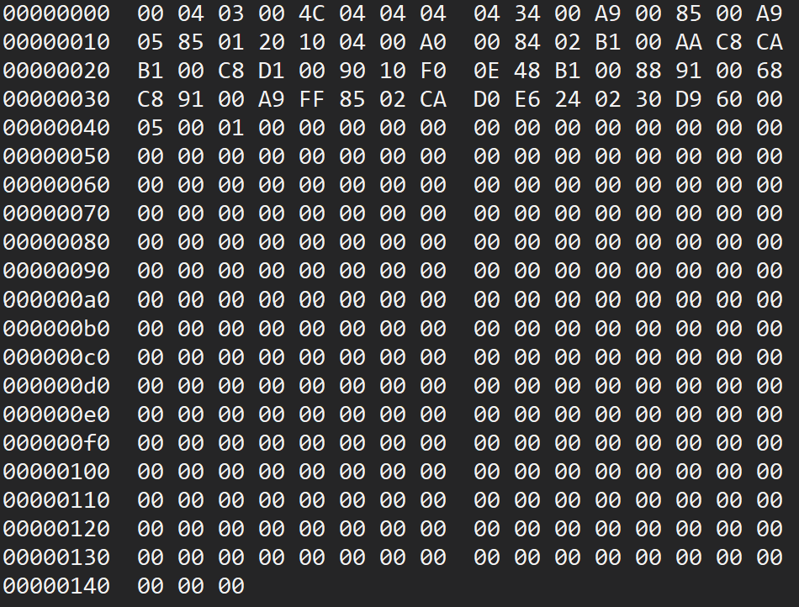
Programming the CPU
Machine Code
When you run any application this is the code the computer is actually running!
Lowest level of software
Binary language processed directly by the CPU
Simple instructions
Load a value in to register
Jump to an address
Add two numbers
Branch depending on value of status flag

Slide 10
Structure of an Instruction
OpCode => What to do
Load a value into the Accumulator
Encoded together in 1 byte
Addressing mode => How to resolve the operand
You’ll find the address of the value to load in the next two bytes
0 to 3 byte depending on addressing mode
Operand => What act on
The address of the value to load

Slide 11
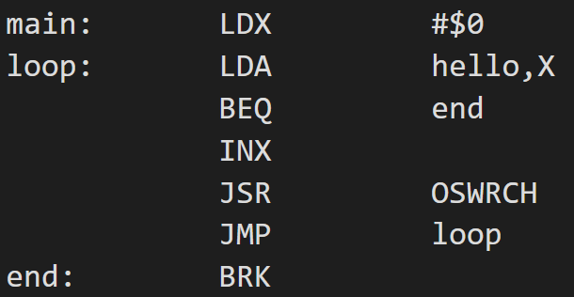
Programming the CPU
Assembly Language
Operand & addressing mode
Human readable form of machine code
1:1 correspondence with machine code
This is NOT a higher-level language
An assembler translates assembly language into machine code for execution
Label
Op code

Slide 12
6502 MC/Assembly Language
56 Op Codes
13 Addressing Modes
CLC – Clear the Carry flag
LDA – Load accumulator
INX – Increase X
ADC – Add to the accumulator
BEQ – Branch if Zero flag is set
ROR – Rotate bits right
JSR – Jump to a subroutine
Implicit - CLC
Accumulator – LSR A
Immediate – LDA #10
Zero page – LDX $10
Zero page, X – AND $20, X
Zero page, Y – STX $30, Y
Relative – BEQ $26
Absolute – JMP $20FE
Absolute, X – STA $3000, X
Absolute, Y – AND $2000, Y
Indirect - JMP ($FFCC)
Indexed Indirect - LDA ($40), A
Indirect Indexed – LDA ($40, A)

Slide 13
Execution Process

Slide 14
Aside – comparison with a modern system

Slide 15
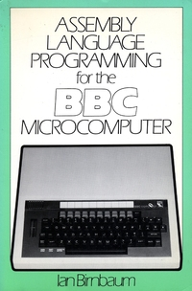
…
Assembly language primer
Tool chain – assembler
Implemented functionality
OS interception
… features
Pull from readme
Internal architecture
Show example of translation

Slide 16
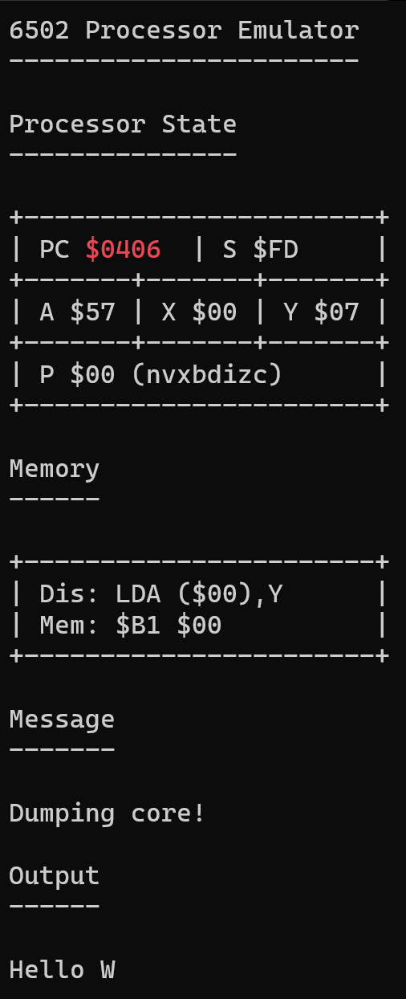
Single step
Run to completion
Dump core
Exit
Registers
Current instruction
Emulator messages
Program output

Slide 17
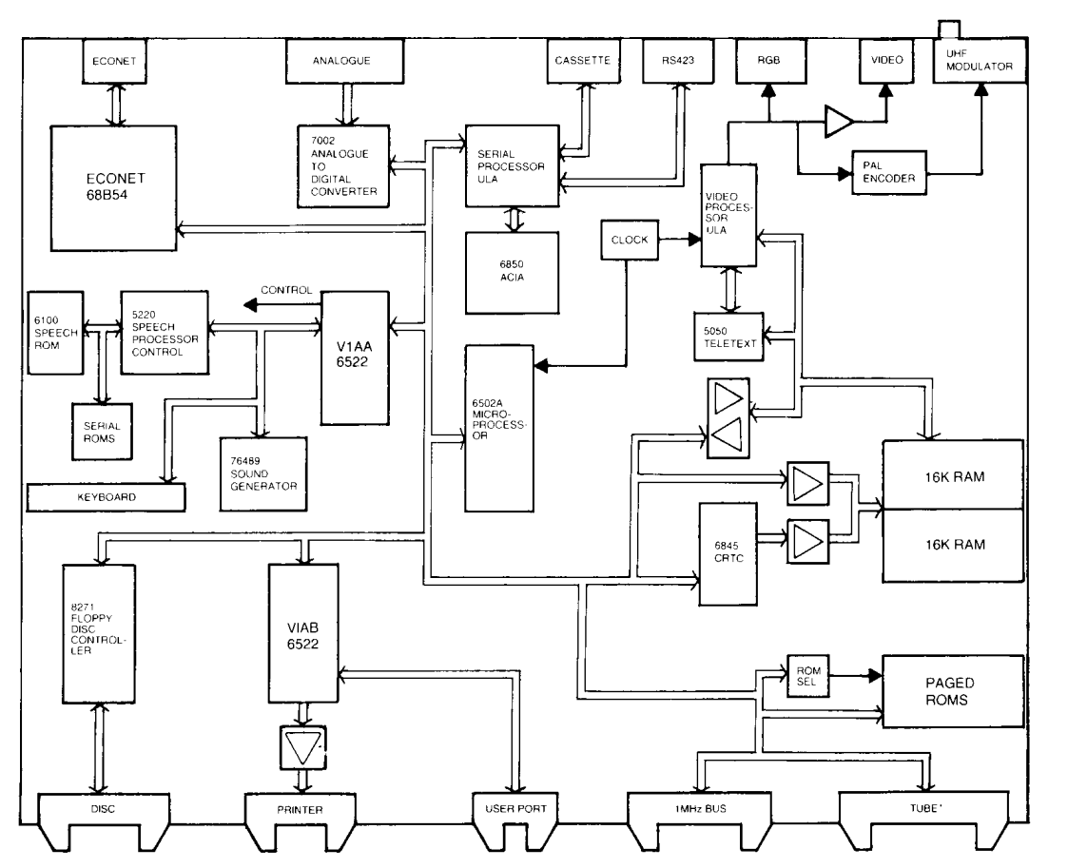
Done
Required
Unsure
From the BBC Microcomputer Advanced User Guide

Slide 18
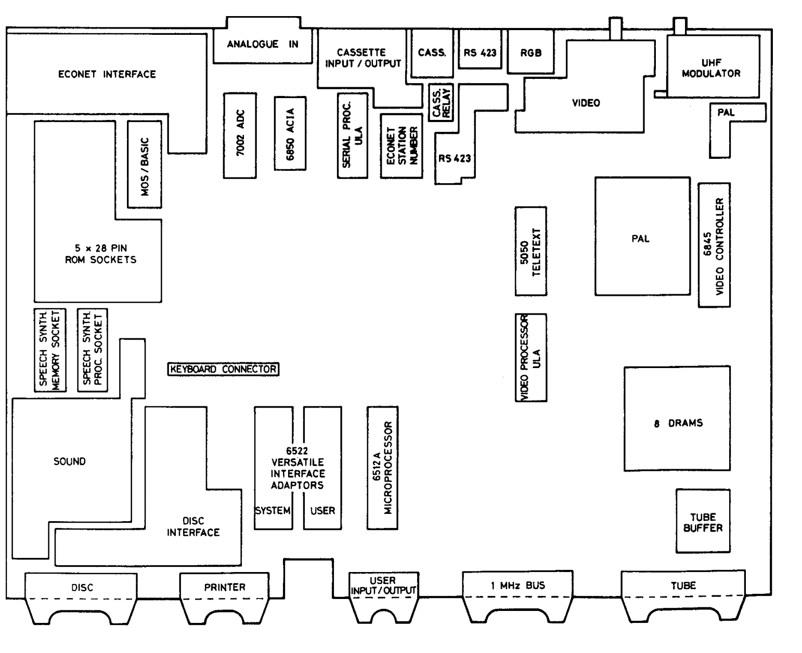

Slide 19
